Slide 1


Marwadi Education Foundation’s Group of Institutions Faculty of Computer Applications MCA Sem- III
Fundamental of Java Programming
(630002)
Unit – 2
Interface

Slide 2
Introduction
Since beginning we know that java does not support multiple Inheritance. Because we can’t write like
class A extends B extends C
On the other hand we also know that multiple inheritance is also 100% useful tool. So java provided us a new approach known as interfaces.
Remember that : java class cannot be a subclass of more than one Super class but it can implement more than one interface.

Slide 3
Defining Interface
In general words we can say interface is basically a kind of class. Like classes in iterfaces it also contains methods, variables etc. but with some difference. The main difference is in interface we can define only abstract methods and final fields.
Syntax :
interface <interface name>
{
variable declaration;
methods declaration;
}

Slide 4
Defining Interface
Example
interface Item
{
static final int code=1001;
static final String name=“Fan”;
void display();
}

Slide 5
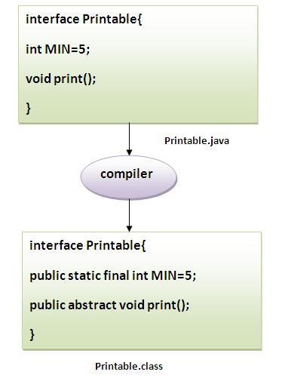
Defining Interface

Slide 6
Extending Interface
Just like simple class we can extend one interface to another also. The new interface will inherit all the members of the super interface in the same manner like subclass syntax :
interface i2 extends i1
{
body of i2;
}

Slide 7
Extending Interface
Example :
interface ItemConstants
{
static final int code=1001;
static final string name=“Fan”;
}
interface Item extends ItemConstants
{
void display();
}

Slide 8
Implementing Interface
Interfaces are used as a super class which we can inherit in our class which is must.
syntax :
class <clasname> implements <interfacename>
{
body of class
}
Remember that : We can implement more then one interface into one class by implementing more then one interface separated by comma.

Slide 9
Implementing Interface
class <classname> extends <superclass>
implements <interface1>,<interface2>….
{
body of the class
}
ex\ex20.java

Slide 10
Implementing Hybrid inheritance
Interface can be used to declare a set of constants that can be used in different classes.
we can use one class to be extended and more than one interfaces to be implemented.
ex\ex21.java

Slide 11
Thank You

